Slide 1
How We Stopped a Crypto Mining Attack in K8s Caused by Next.js RCE

Slide 2
How many of you are running Kubernetes security controls?
Runtime Thread Detection
Automated Thread Response
Forensics & Investigation
Hardening

Slide 3
Why This Talk Matters

Slide 4
React2Shell (CVE-2025-55182)
What is it? Pre-authentication Remote Code Execution (RCE) in React Server Components that allows attackers to execute arbitrary code on vulnerable Next.js applications using a single crafted HTTP request.
Why It Matters
No login or credentials required
Single HTTP request exploitation
Enabled by default in affected Next.js versions
Can lead to crypto-mining, malware deployment, and full server compromise
Global Impact 🌐 165,000+ vulnerable IPs 🌐 644,000+ exposed domains detected worldwide
Attack Chain HTTP Request → RCE → Crypto Miner Deployment → Resource Theft

Slide 5
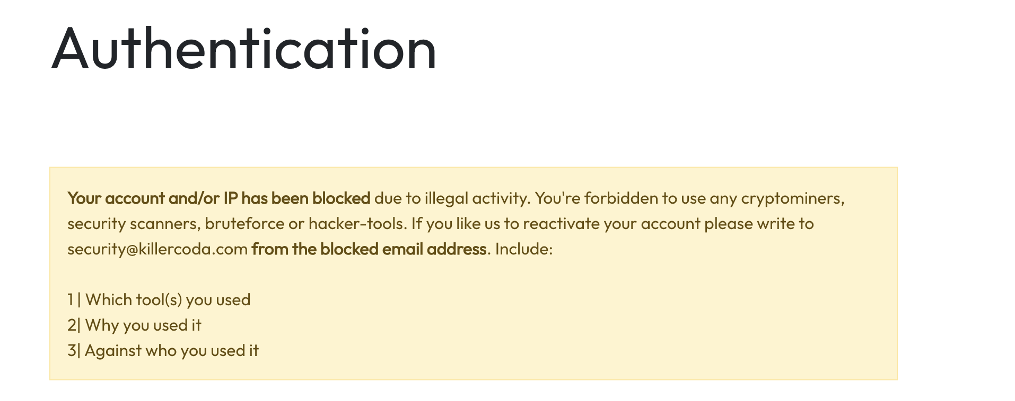
Runtime Detection in Action

Slide 6

Hands-On Demo
https://killercoda.com/kubecon26-nextjs-demo/scenario/faloc-demo

Slide 7
Key Learnings

Slide 8
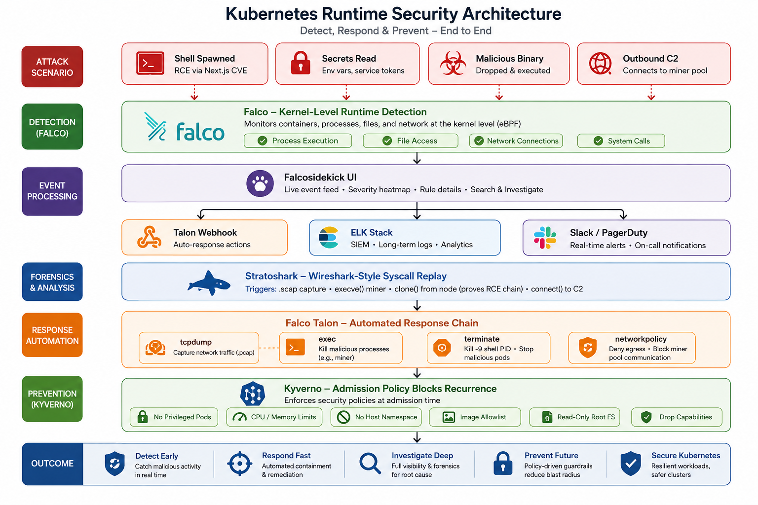

Slide 9
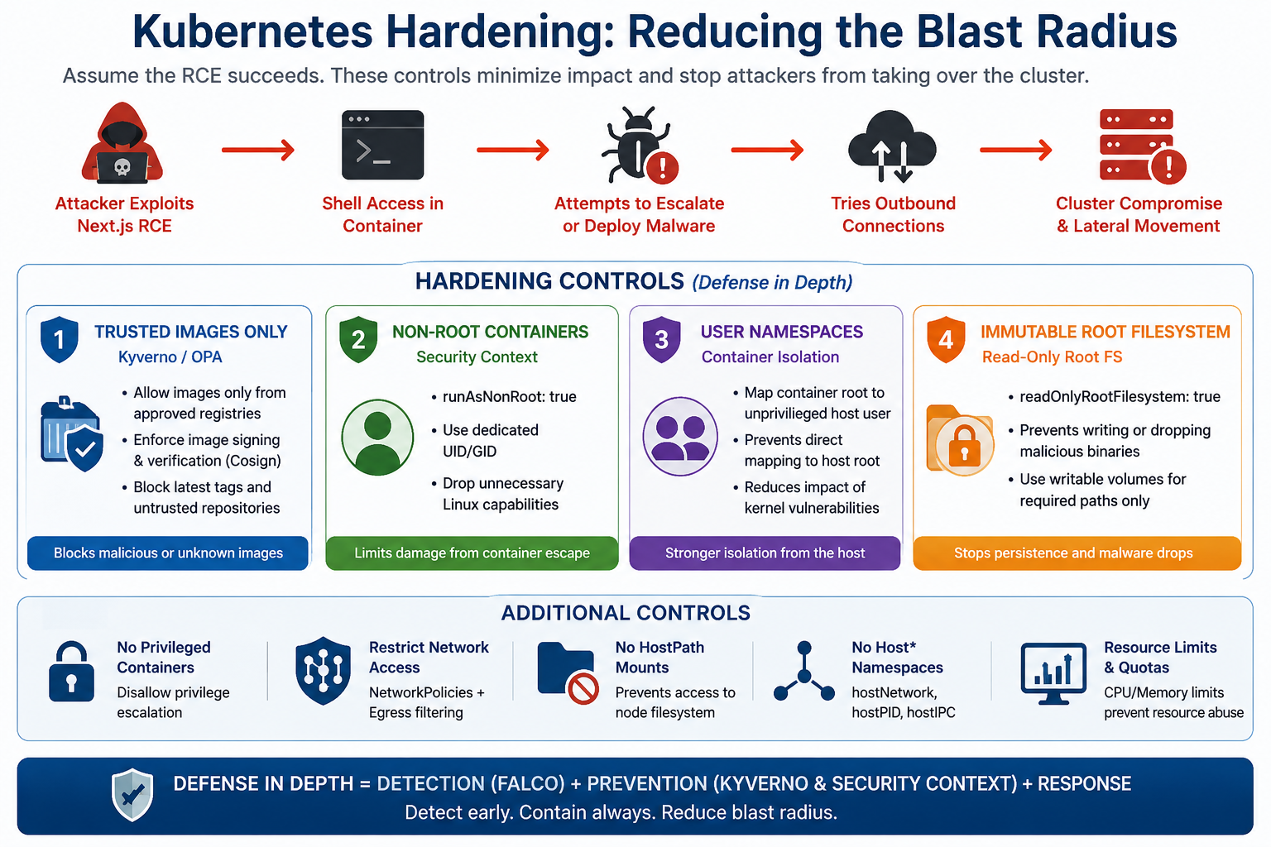

Slide 10
Thank You
Ref : https://github.com/tamilhce/kubecon26

